Slide 1
Mannheim

Slide 2
Mannheim
> 9.500 parking places in car parks/parking lots¹
> 6.800 parking places on the street¹

Slide 3
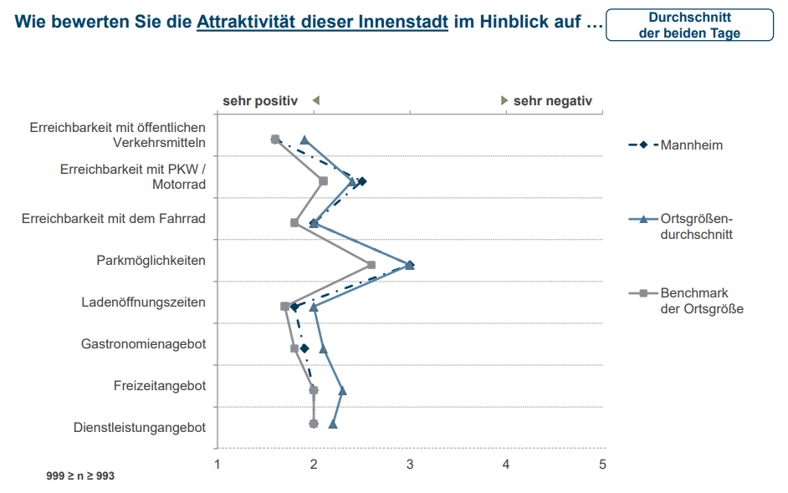
Mannheim
> 9.500 parking places in car parks/parking lots¹
> 6.800 parking places on the street¹
2

Slide 4
Data

Slide 5
Car park occupancies

Slide 6
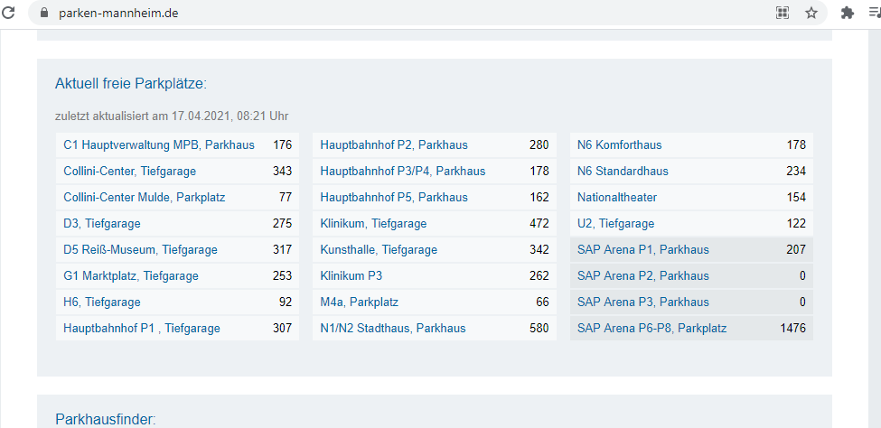
Car park occupancies
https://www.parken-mannheim.de/

Slide 7
Car park occupancies
https://www.parken-mannheim.de/
Updated every 3 min

Slide 8
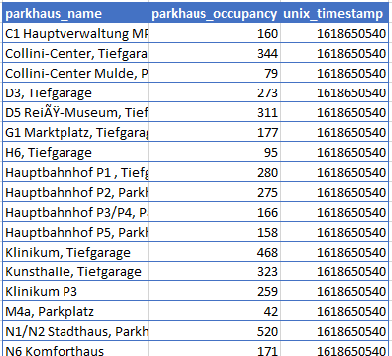
Car park occupancies
https://www.parken-mannheim.de/
Updated every 3 min

Slide 9
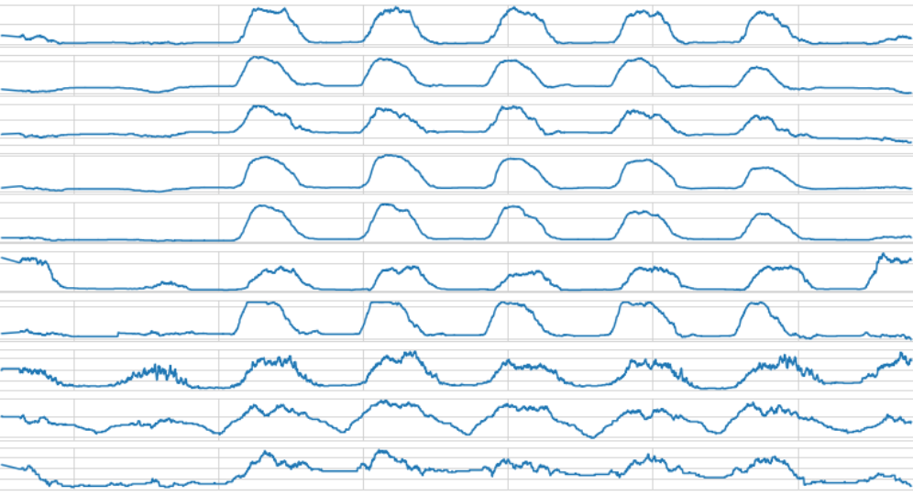
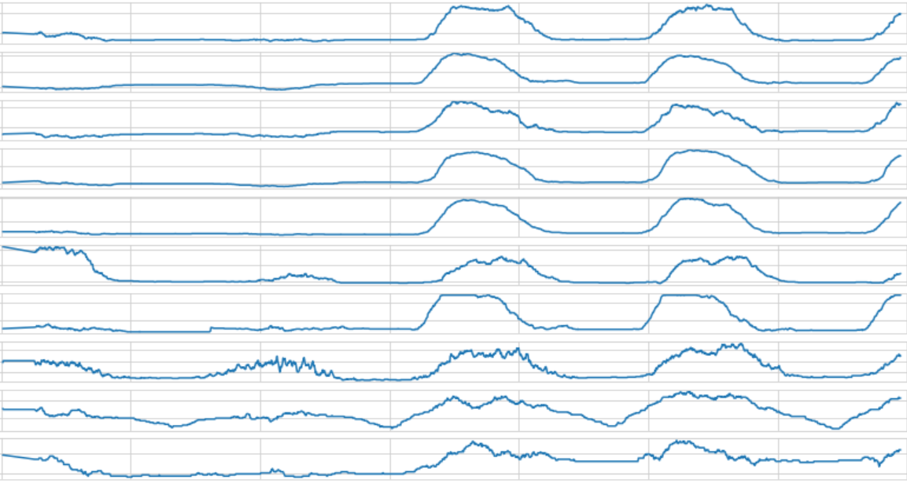
C1 Hauptverwaltung MPB, Parkhaus
Collini-Center, Tiefgarage
Collini-Center Mulde, Parkplatz
D3, Tiefgarage
D5 Reiß-Museum, Tiefgarage
G1 Marktplatz, Tiefgarage
H6, Tiefgarage
Hauptbahnhof P1 , Tiefgarage
Hauptbahnhof P2, Parkhaus
Hauptbahnhof P3/P4, Parkhaus
Sa
So
Mo
Tue
We
Thu
Fr
Sa

Slide 10
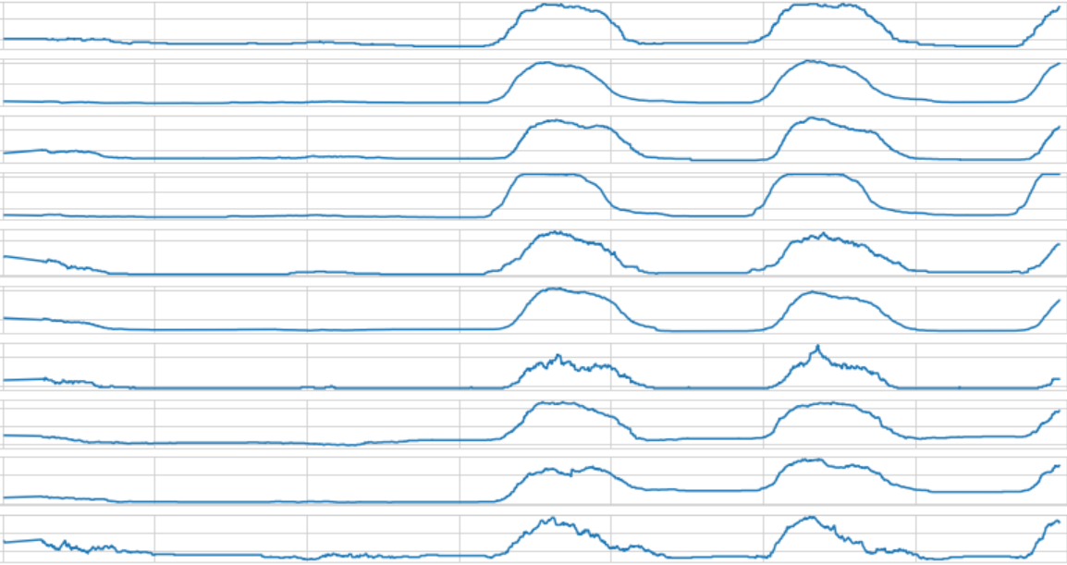
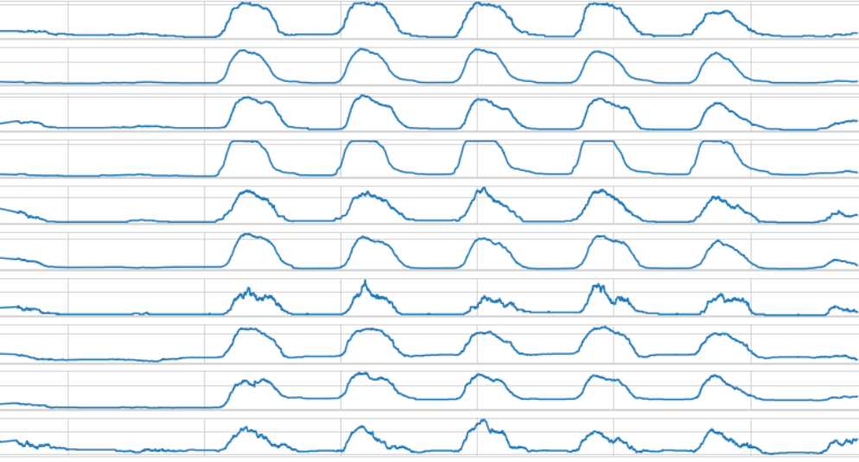
Hauptbahnhof P5, Parkhaus
Klinikum, Tiefgarage
Kunsthalle, Tiefgarage
Klinikum P3
M4a, Parkplatz
N1/N2 Stadthaus, Parkhaus
N6 Komforthaus
N6 Standardhaus
Nationaltheater
U2, Tiefgarage
Sa
So
Mo
Tue
We
Thu
Fr
Sa

Slide 11
Theory

Slide 12
price (€)
supply
demand

Slide 13
price (€)
supply
demand

Slide 14
supply(price)
demand(price)
price

Slide 15
suppy(price)
demand(price)
price

Slide 16
demand(price)
price

Slide 17
demand(price)
price

Slide 18
demand(price)

Slide 19
demand(price, location)

Slide 20
demand(price, location, time)

Slide 21
demand(price, location, time)
Other factors:
knowledge

Slide 22
demand(price, location, time)
Other factors:
knowledge
disposable income

Slide 23
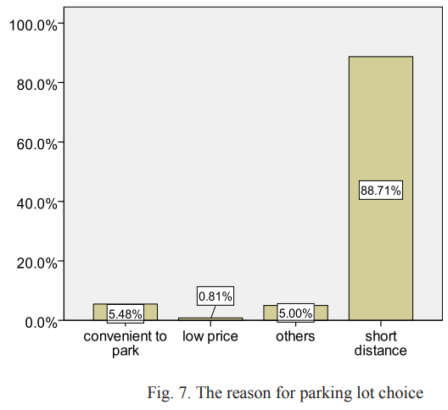
3
demand(price, location, time)
Other factors:
knowledge
disposable income

Slide 24
1
demand(price, location, time)
Other factors:
knowledge
disposable income

Slide 25
1
demand(price, location, time)
Other factors:
knowledge
disposable income
2

Slide 26
1
demand(price, place, time)
Other factors:
knowledge
disposable income
2
3

Slide 27
1. demand(price, place, time)

Slide 28
demand(price, place, time)
Assumption:
Price, place and time have an independent effect on the demand
=>
demand (price, place, time) = k * demand(price)
* demand(place)
* demand(time)

Slide 29
demand(price, place, time)
Assumption:
Price, place and time have an independent effect on the demand
=>
demand (price, place, time) = k * demand(price)
* demand(place)
* demand(time)
1.1

Slide 30
demand(price, place, time)
Assumption:
Price, place and time have an independent effect on the demand
=>
demand (price, place, time) = k * demand(price)
* demand(place)
* demand(time)
1.1
1.2

Slide 31
demand(price, place, time)
Assumption:
Price, place and time have an independent effect on the demand
=>
demand (price, place, time) = k * demand(price)
* demand(place)
* demand(time)
1.1
1.2
1.3

Slide 32
1.1. demand (price)

Slide 33
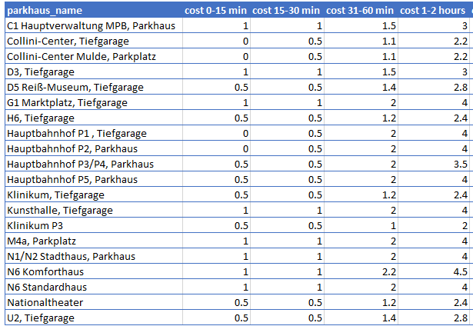
Expected price
…
…
…

Slide 34
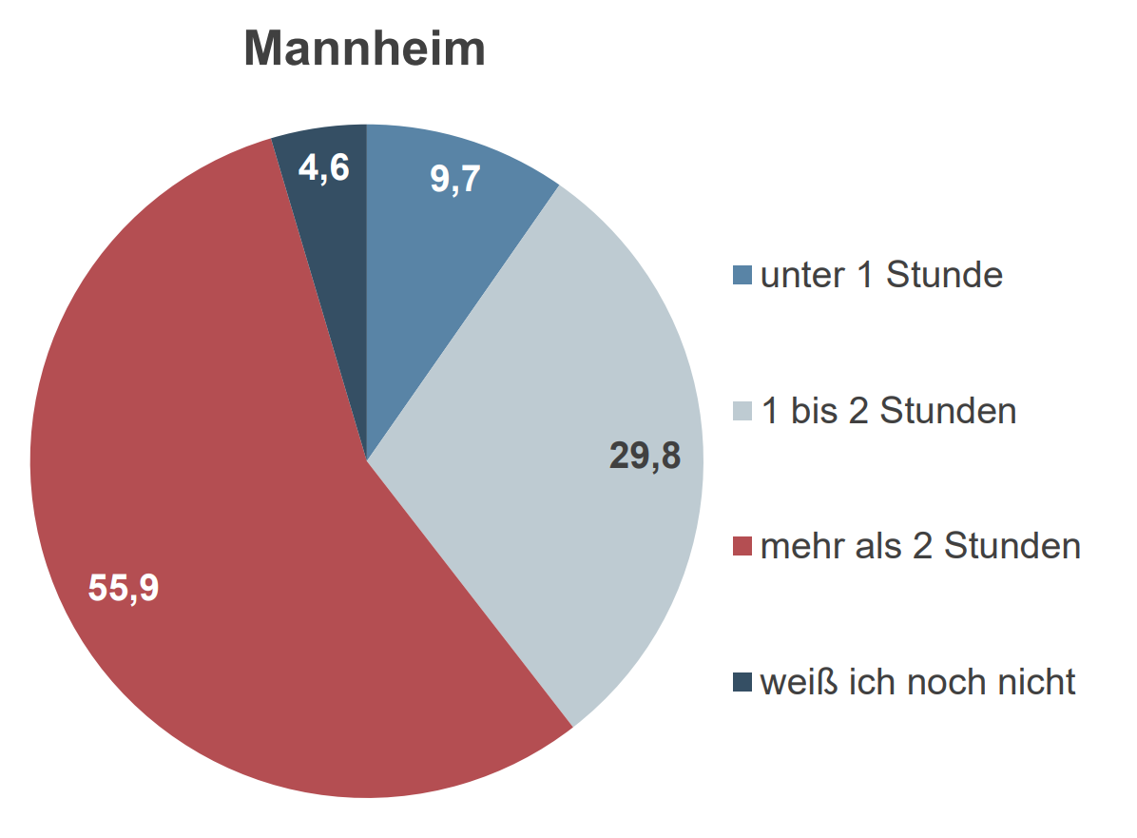
Expected price
…
…
…
Quelle: Vitale Innenstädte 2018 Mannheim²

Slide 35
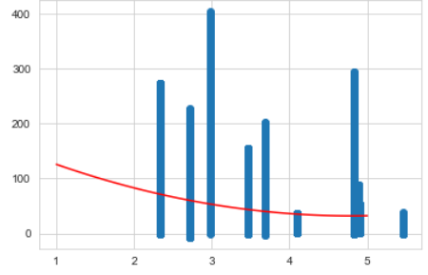
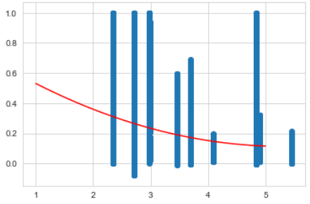
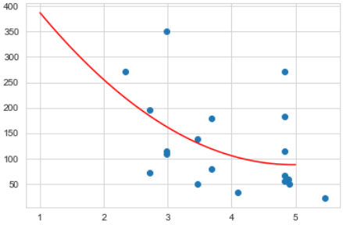
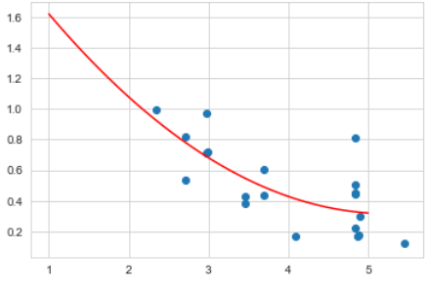
Polynomial Regression
Number_of_parked_cars (price)
Percent_occupied (price)
all data
Monday, 13:00

Slide 36
1.2 demand (place)

Slide 37
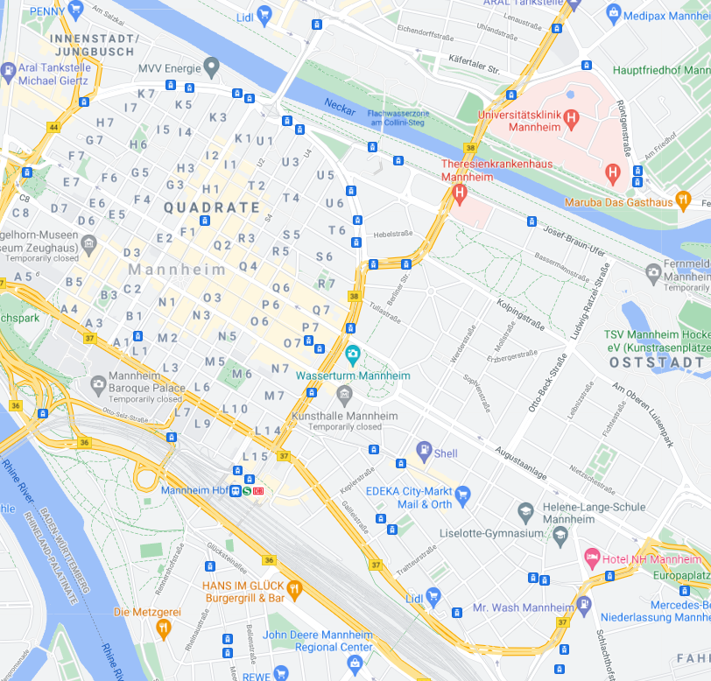
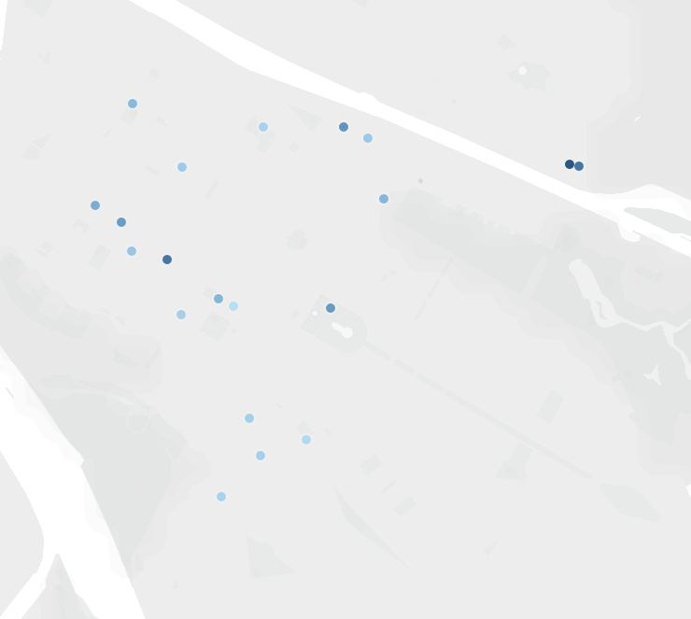
Monday, 13:00

Slide 38
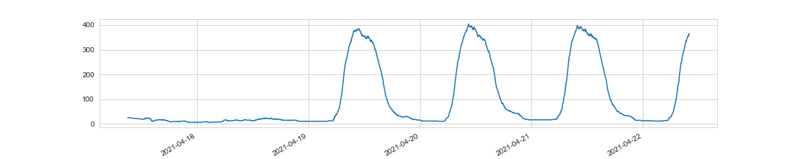
Monday, 13:00
Klinikum, Tiefgarage (351)

Slide 39
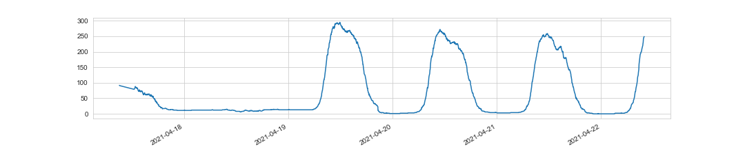
Monday, 13:00
N1/N2 Stadthaus Parkhaus (271)
Klinikum, Tiefgarage (351)

Slide 40
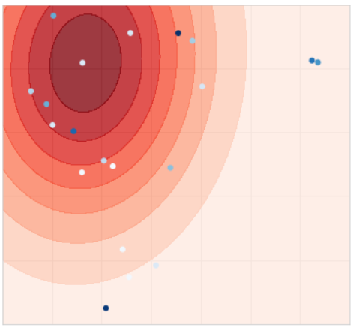
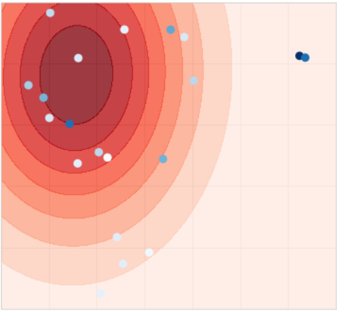
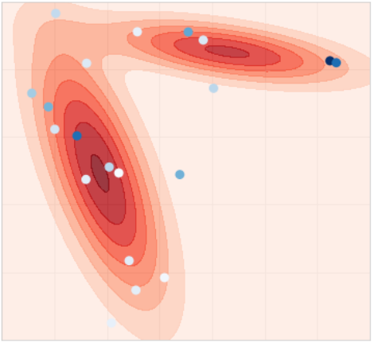
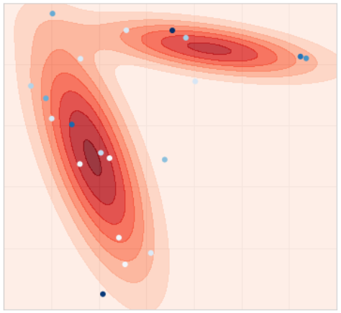
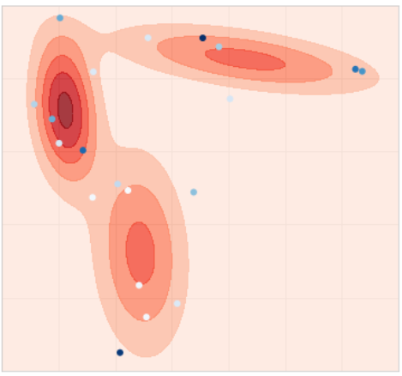
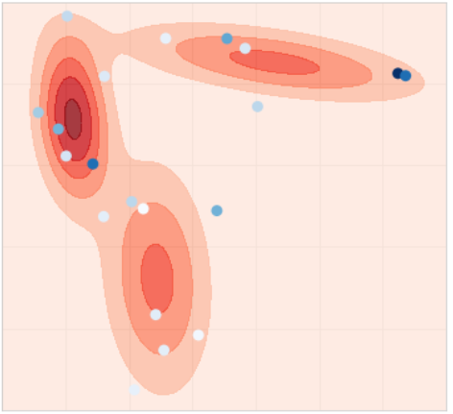
Gaussian Mixture Model
n = 1
n = 2
n = 3

Slide 41



Gaussian Mixture Model
n = 1
n = 2
n = 3

Slide 42
Gaussian Mixture Model
demand (place)
n = 1
n = 2
n = 3

Slide 43
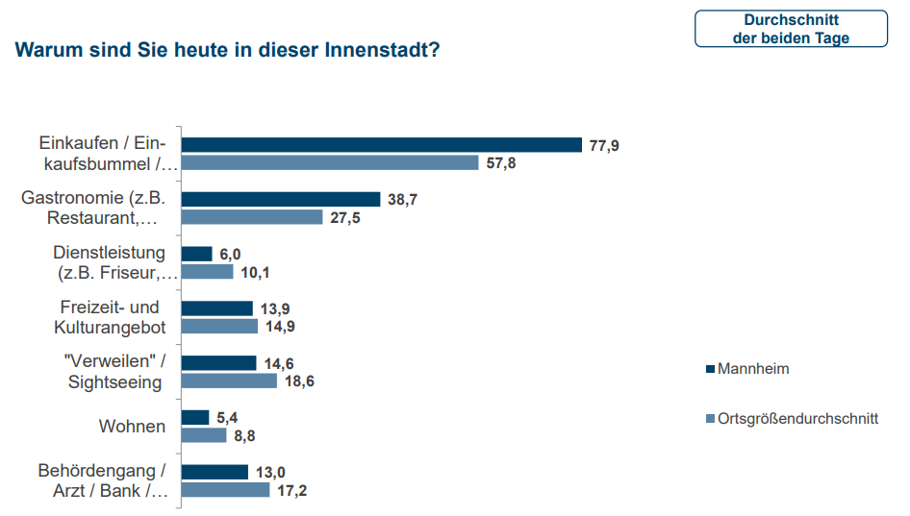
Vitale Innenstädte 2018 – Mannheim²
Sample size: 1013 participants

Slide 44
1.3 demand (time)

Slide 45
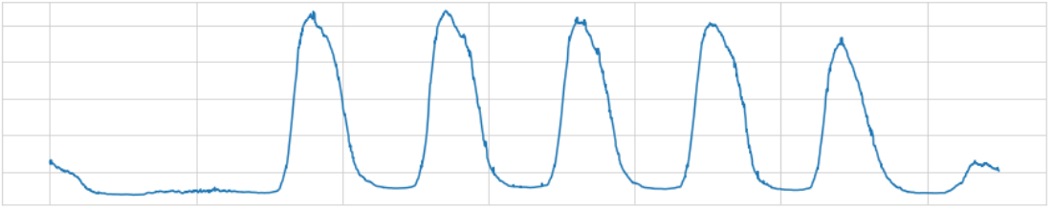
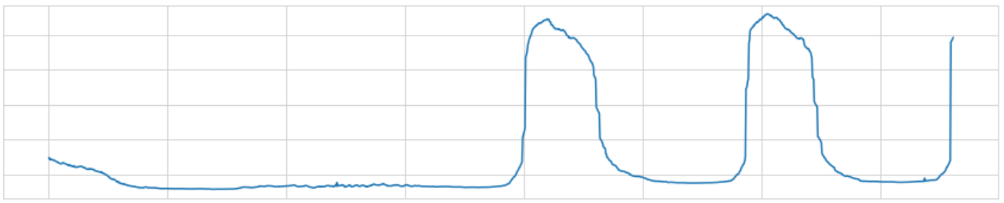
Sa
So
Mo
Tue
We
Thu
Fr
Sa

Slide 46
11:30
16:00-18:00
7:30

Slide 47
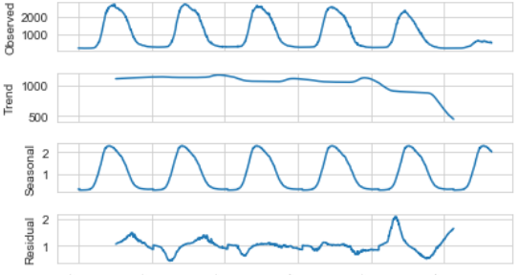
Seasonal Decomposition

Slide 48
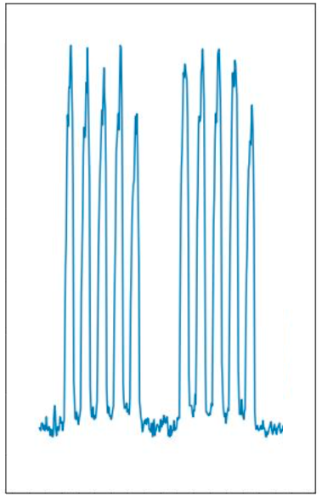
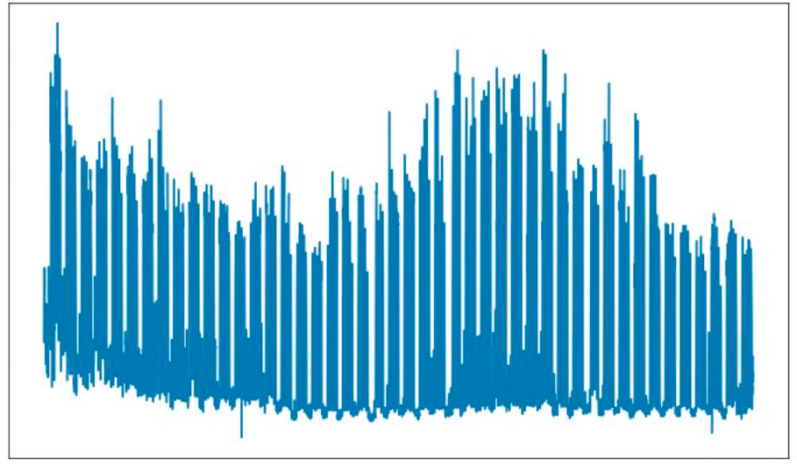
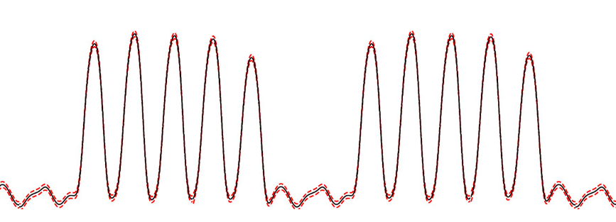
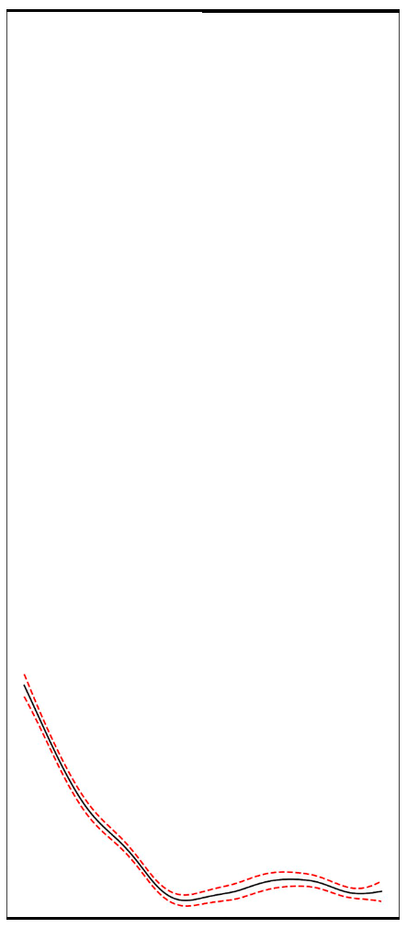
Generalized Additive Model
+

Slide 49
Assumption: independent effects on demand

Slide 50
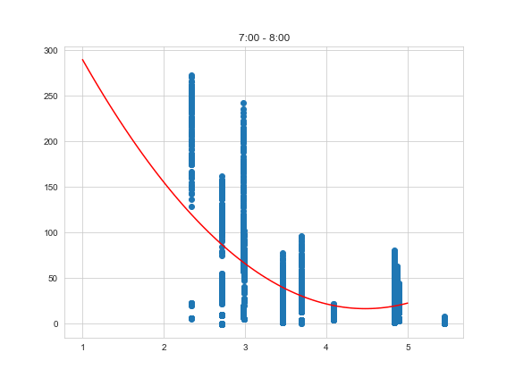
Price and Time

Slide 51
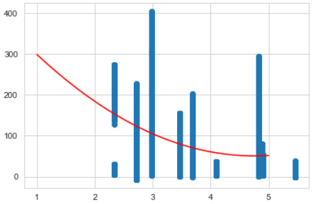
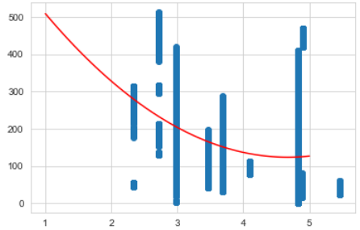
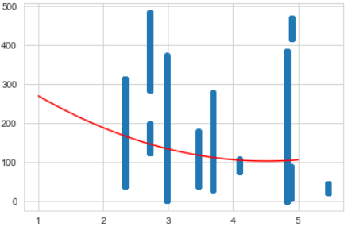
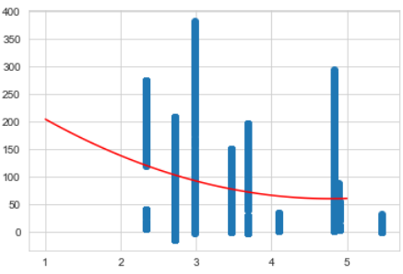
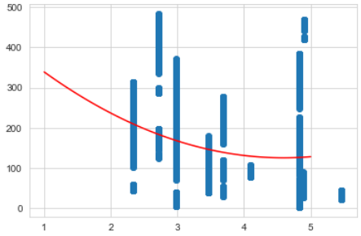
Price and Time
morning (7:00-12:00)
afternoon (12:00 – 16:00)

Slide 52
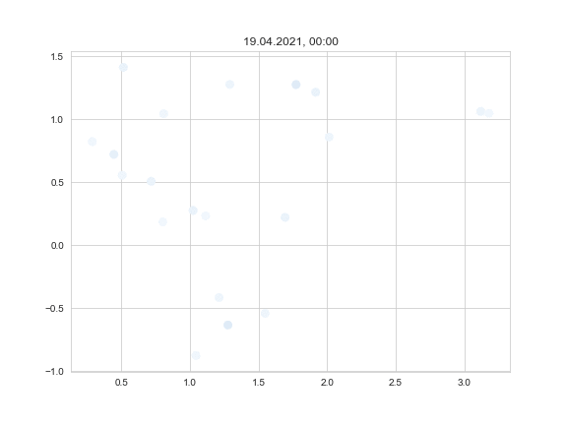
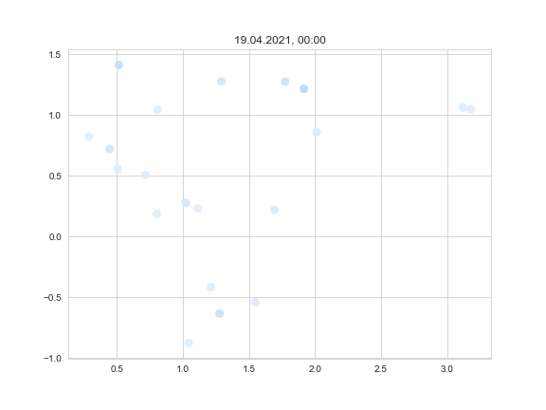
Place and Time
number_of_parked_cars(time)
percent_occupied(time)

Slide 53
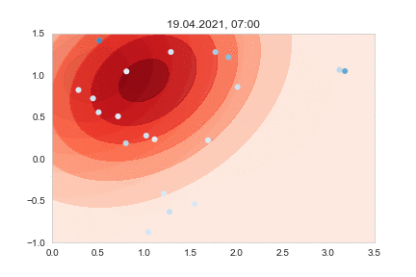
Place and Time
number_of_parked_cars(time)
percent_occupied(time)

Slide 54
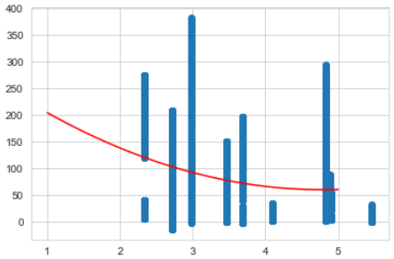
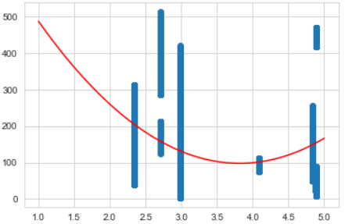
Price and Place
In Quadrate
outside Quadrate

Slide 55
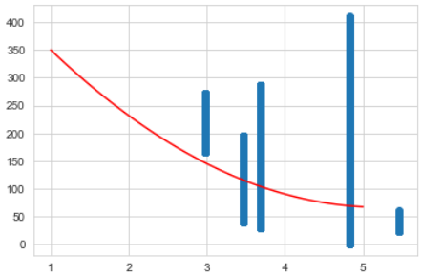

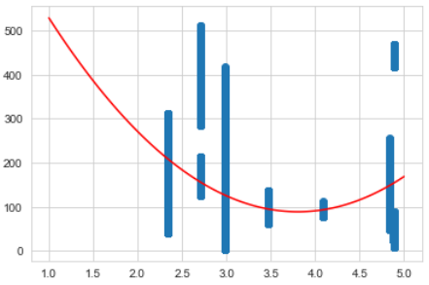
Preis und Ort
In den Quadraten
Außerhalb der Quadrate
Im Osten
Im Westen

Slide 56
demand(price, place, time)

Slide 57
demand(price, place, time) = k * demand(price)
* demand(place)
* demand(time)
Log(demand(price, place, time)) = Log(k * demand(price)
* demand(place)
* demand(time))
Log(demand(price, place, time)) = Log(k) + Log(demand(price))
+ Log( demand(place))
+ Log( demand(time))
Log(demand(price, place, time)) = k₀ + k₁*Log(demand (price)) + k2*…

Slide 58
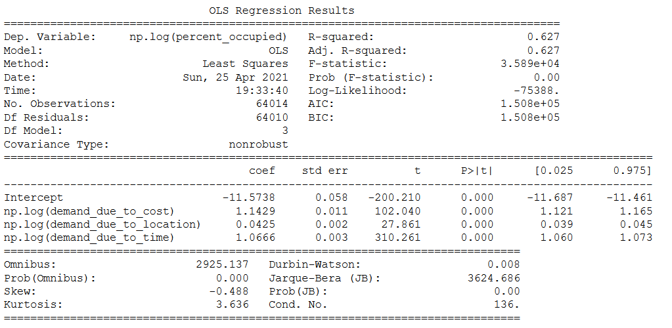
Log(demand(price, place, time)) = k₀ + k₁*Log(demand (price)) + k2*…
k₀
k₁
k₂
k₃

Slide 59
C1 Hauptverwaltung MPB, Parkhaus
Collini-Center, Tiefgarage
Collini-Center Mulde, Parkplatz
D3, Tiefgarage
D5 Reiß-Museum, Tiefgarage
G1 Marktplatz, Tiefgarage
H6, Tiefgarage
Hauptbahnhof P1 , Tiefgarage
Hauptbahnhof P2, Parkhaus
Hauptbahnhof P3/P4, Parkhaus

Slide 60
C1 Hauptverwaltung MPB, Parkhaus
Collini-Center, Tiefgarage
Collini-Center Mulde, Parkplatz
D3, Tiefgarage
D5 Reiß-Museum, Tiefgarage
G1 Marktplatz, Tiefgarage
H6, Tiefgarage
Hauptbahnhof P1 , Tiefgarage
Hauptbahnhof P2, Parkhaus
Hauptbahnhof P3/P4, Parkhaus
market
train station

Slide 61
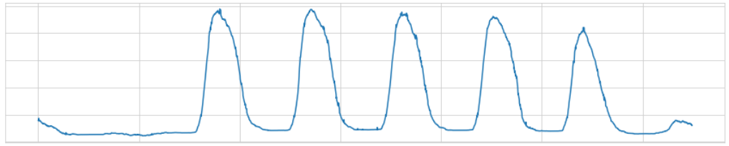
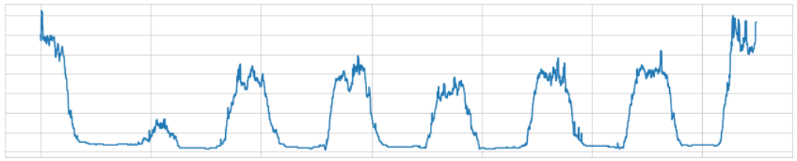
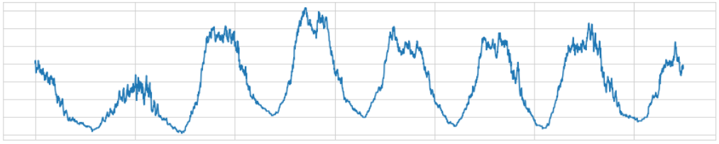
total
normal
market
train station

Slide 62
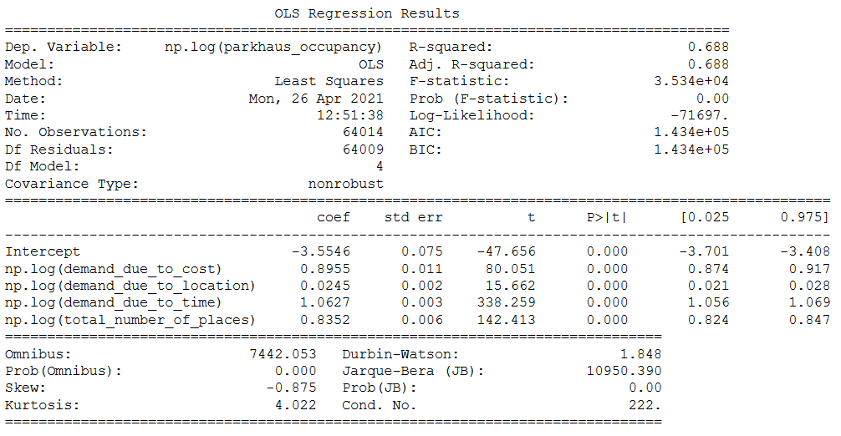

Slide 63
Error analysis

Slide 64





C1 Parkhaus
Collini-Center, Tiefgarage
Collini-Center Mulde, Parkplatz
D3, Tiefgarage
D5 Reiß-Museum, Tiefgarage

Slide 65





G1 Marktplatz, Tiefgarage
H6, Tiefgarage
Hauptbahnhof P1
Hauptbahnhof P2
Hauptbahnhof P3/P4

Slide 66





Hauptbahnhof P5, Parkhaus
Klinikum, Tiefgarage
Kunsthalle, Tiefgarage
Klinikum P3
M4a, Parkplatz

Slide 67





N1/N2 Stadthaus, Parkhaus
N6 Komforthaus
N6 Standardhaus
Nationaltheater
U2, Tiefgarage

Slide 68

C1 Parkhaus
Collini-Center
Collini-Center Mulde
D3, Tiefgarage
D5 Reiß-Museum
G1 Marktplatz
H6, Tiefgarage
Hauptbahnhof P1
Hauptbahnhof P2
Hauptbahnhof P3/P4
Hauptbahnhof P5
Klinikum, Tiefgarage
Kunsthalle
Klinikum P3
M4a, Parkplatz
N1/N2 Stadthaus
N6 Komforthaus
N6 Standardhaus
Nationaltheater
U2, Tiefgarage
100%
50%
0%

Slide 69
2. Knowledge

Slide 70
Simulation-based inference (Approximate Bayesian Computation)

Slide 71
Number of known car parks: ?
Simulation-based inference (Approximate Bayesian Computation)

Slide 72

Simulation-based inference (Approximate Bayesian Computation)

Slide 73
Simulation-based inference (Approximate Bayesian Computation)

Slide 74
Parkhäuser
accessibility = 4
accessibility = 3
accessibility = 5
accessibility = 2

Slide 75
Anzahl an bekannten Parkhäusern: 2
Parkhäuser
accessibility = 4
accessibility = 3
accessibility = 5
accessibility = 2

Slide 76
Anzahl an bekannten Parkhäusern: 2

Slide 77
Anzahl an bekannten Parkhäusern: 2

Slide 78
Anzahl an bekannten Parkhäusern: 2

Slide 79
Anzahl an bekannten Parkhäusern: 2

Slide 80
Anzahl an bekannten Parkhäusern: 3

Slide 81
Plate Diagram
P
D
Q
V_{d}
C_{d,q}
n
P – distribution of car parks weighted by accessibility
N – number of car parks viewed
V_{d} – per driver: distribution of viewed car parks
D – number of drivers Q – number of chosen car parks
C_{d,q} – chosen car park

Slide 82


Slide 83
Future investigations: models

Slide 84
…personalized model of parking behaviour
C1 Hauptverwaltung MPB, Parkhaus
Collini-Center, Tiefgarage
Collini-Center Mulde, Parkplatz
D3, Tiefgarage
D5 Reiß-Museum, Tiefgarage
G1 Marktplatz, Tiefgarage
H6, Tiefgarage
Hauptbahnhof P1 , Tiefgarage
Hauptbahnhof P2, Parkhaus
Hauptbahnhof P3/P4, Parkhaus

Slide 85
Future investigations: data

Slide 86
Ideas for possible data sources
best: Experimental data
Data from existing research on parking behaviour
Distribution of car brands in different car parks
Survey of parkers (parking-place-finding process, socio-economic class)
Survey of traffic wardens
GPS traffic data
On-street parking API

Slide 87
On-Street Parking API

Slide 88



On-Street Parking API
Parking-Apps

Slide 89






On-Street Parking API
On-Street Parking API
Parking-Apps

Slide 90
On-Street Parking API
On-Street Parking API
Parking-Apps
real-time
parking statistics

Slide 91
On-Street Parking API
On-Street Parking API
Parking-Apps
real-time
parking statistics

Slide 92



weight = probability(not finding a place)

Slide 93




Gaussian Mixture Model
n = 1
n = 2
n = 3
n = 4

Slide 94


Google Maps traffic

Slide 95

particulate matter sensors

Slide 96
Thank you!

Slide 97
References

Slide 98
1.
Stadt Mannheim. Parken in Mannheim. Retrieved Mai 1, 2021, from https://www.mannheim.de/de/service-bieten/verkehr/parken
2.
Sondermann, N. (2018). Vitale Innenstädte 2018 Mannheim. IFH Köln GmbH. https://www.mannheim.de/sites/default/files/2019-02/Vitale%20Innenst%C3%A4dte%202018%20Mannheim.pdf
3.
Xiaolong Ma, Xiaoduan Sun, Yulong He, and Yixin Chen. Parking Choice Behavior Investigation: A Case Study at Beijing Lama Temple. Procedia - Social and Behavioral Sciences, 96(Cictp):2635–2642, 2013. ISSN 18770428. https://doi.org/10.1016/j.sbspro.2013.08.294.

